Slide 1
Requirements Engineering
Volere Process (cont.) at Step 2 : Trawling the Requirements

Slide 2
Functional requirements
Functional requirements describe what the product must do to carry out the work for which it is intended. They are independent
of any technology used by the product.
The product shall record the new weather stations.

Slide 3
Quality requirements

Slide 4
More requirements
software always has to meet a certain quality
level; e.g, think of throughput or usability
software may also have to comply with
certain technological or legal constraints
such properties are additional requirements –
the qualities that the product and its functions
must have
such requirements s are often called "non-functional,"
but this is a nonsense term...

Slide 5
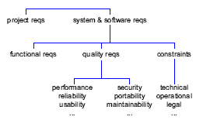
A requirements hierarchy

Slide 6
Scope of quality requirements
quality reqs have different scopes:
some apply to a particular functional req
some apply to a use case as a whole
some apply to the entire product
the quality reqs often are crucial
for the success of the product

Slide 7
Trawling for quality reqs (1)
quality issues naturally come up when
trawling for functional requirements
hence, quality reqs get collected "over time"
during analysis
in addition, the analyst must ask specific
quality-related questions when discussing
product use cases and functional reqs
use a checklist of quality categories

Slide 8
Trawling for quality reqs (2)
when talking to users of the product, ask for
usability – look and feel – security – cultural reqs
when talking about the operating environment
of the product, ask for
performance – interface – maintainability –
security reqs
when talking to managers and marketing
people, ask for
look and feel – political – security – legal reqs

Slide 9
Ex: A functional requirement
Produce road de-icing schedule
6. Product schedules available trucks from
the relevant depots.
7. Product advises the engineer of the schedule.
this product use case scenario will give a
functional requirement:
The product shall produce a de-icing schedule showing the roads to be treated and the trucks allocated to them.

Slide 10
Ex: A usability requirement
for sure, the stakeholders want the schedule to enable an engineer to easily direct the trucks to the correct roads,
this gives a usability requirement:
The product shall produce a schedule that is easy
to read.

Slide 11
Ex: Another usability requirement
when thinking about the targeted users of the product, more usability reqs come up e.g., the customer tells you that they often employ new junior engineers
this gives another usability requirement:
The product shall be intuitive to use.
but how to make sure that this property has
been achieved?

Slide 12
Fit criteria
to clarify a quality requirement, it helps to establish a fit criterion that will measure whether the software meets the requirement or not
The product shall be intuitive to use.
Criterion: A new engineer shall be able to produce a correct
de-icing forecast within 10 mins of encountering the product
for the first time without reference to any out-of-product help.
conformance could be tested in a user study

Slide 13
Ex: Look and feel requirements
The product shall conform to the established look and feel of the organization's products.
Criterion: Sixty percent of the target audience will recognize the product as belonging to the corporation within 5 secs of encountering it for the first time.
note that this requirement does not say the company logo must be prominent, nor does it talk about the colors to be used; simply conform to whatever the standards are

Slide 14
Ex: Performance requirements
The product shall accommodate the largest
geographical area of any road authority in the UK.
again, a fit criterion should be added alternatively, when specifying numbers a rationale should explain the numbers:
The product shall have the capacity for 5000 roads.
Rationale: The maximum number of roads in the area of any potential customer for the product.

Slide 15
Ex: Performance fit criteria
The product must produce the road de-icing
schedule in an acceptable time.
gets clearer when thinking about how failure of this req could be measured:
The product must produce the road de-icing....
Criterion: The road de-icing schedule shall be available to the engineer within 15 secs from making his request for 90 percent of the times. It shall never take longer than 20 secs.

Slide 16
Ex: Maintainability requirements
The product shall enable the addition of new road authority areas within two days.
already contains its fit criterion; conformance could be tested in a user study

Slide 17
Ex: Legal requirements
The product shall comply with ISO 93.080.99.
legal reqs often lead to additional functional reqs, f.e.:
The product shall produce an audit report of all
road schedules and their subsequent treatments.
The product shall retain all ice predictions for all
occasions the schedule is run.

Slide 18
Ex: Operational constraints
The product shall interface with the DM31 weather
stations.
Criterion: The interfaces to the Rosa Weather Station shall
be certified as complying with the National Transportation
Communication ITS Protocol (NTC/IP).
again, this constraint will lead to additional
functional requirements, such as establishing a radio
network connection, matching data formats ...

Slide 19
Ex: Project constraints
Time
The product must be available at the beginning of
the new tax year.
And money:
The budget for building the product is £500,000.

Slide 20

Volere Step 2d: Modeling the Data

Slide 21
Business Data
during analysis, model only business data
business data objects naturally occur in the stakeholder's process descriptions
model the statics – business data objects and their logical relationships
caution: it is tempting, but doesn't make much sense to specify "operations" for data objects during analysis – operations are design information

Slide 22
Variety of data diagrams
long-standing:
entity-relationship diagram (ERD)
statechart
state transition table
with UML:
class diagram
state diagram

Slide 23
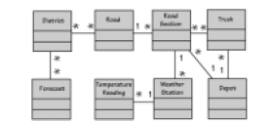
Ex: Business objects as a class diagram(p. 169)
a simple UML class diagram that shows key
business data objects and their relationships

Slide 24
Ex: Functional reqs from data
when talking about the business data objects,
additional reqs naturally come up
f.e., business data often must be stored in the product – a functional req:
The product shall record air-temperature readings,
humidity readings, precipitation readings, and road- temperature readings received from weather stations.

Slide 25
Ex: Quality reqs from data
data often lead to additional quality reqs f.e., performance reqs:
The product shall record data transmitted from a
weather station within half a second.
f.e., security reqs:
The product shall ensure that data recorded from
a weather station cannot be altered, except by a
supervising engineer.

Slide 26
State diagrams
show the states of an object, plus the events that make the object move to its next state
here: business data object and business events
often helps to identify additional requirements
caution: state diagrams have a tendency of getting too close to design...

Slide 27
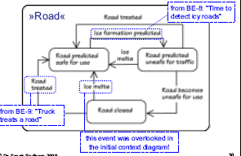
Ex: Business object states

Slide 28
Volere Step 3: Writing the Requirements

Slide 29
Writing individual requirements
is actually done during trawling
the individual requirements must be written down in a structured form ("formalized")
helps with bookkeeping
helps avoid defects, such as requirements that are incomplete or not traceable to a use case
uses a template, in paper form or electronic form

Slide 30
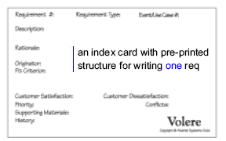
Volere »Shell«

Slide 31
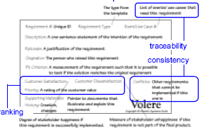
Volere shell explanation

Slide 32
Conflicting requirements
one particular req can make another one less
feasible; for example:
The product shall compute the shortest route to
each destination.
The product shall compute the quickest route to
each destination.
nothing unusual when asking different people
must be resolved, with the client

Slide 33
Ex: Functional requirement in a shell
Requirement #: 75 Req Type :9 Event/Use Case #: 6
Description: The product shall issue an alert if a weather station fails to transmit readings.
Rationale: Failure to transmit readings might indicate that the weather station is faulty and needs maintenance and that the data used to predict the freezing roads may be incomplete.
Originator: Roger Walters, Road engineering Supervisor
Fit Criterion: For each weather station the recorded number of each type of reading per hour shall be within the manufacturer’s specified range of the expected number of readings per hour.
Customer Satisfaction: 3 Customer diSatisfaction: 3
Priority: High
Supporting material:
History: Raised by AG. 25 Aug 05

Slide 34
Ex: Quality req in a shell (fig. 10.7, p. 252)
Requirement #: 110 Req Type :11 Event/Use Case #: 6
Description: The product shall be easy for the road engineers to use.
Rationale: It should not be necessary for the engineers to attend training classes to be able to use the product.
Originator: Sonia henning, Road engineering Supervisor
Fit Criterion: A road engineer shall be able to use the product to sucessfully carry out the cited use cases within 1 hour of first encountering the product.
Customer Satisfaction: 3
Priority: next release
Supporting material:
History: Raised by AG. 25 Aug 05

Slide 35
»The spec«
a document that contains all requirements
SRS = Software Requirements Specification
must contain clear, complete, and testable
instructions about what to build
is the basis for the contract with the client
is clearly structured – uses some sort of template
can be paper, but is often stored using a software tool for reqs management

Slide 36
Writing the spec
this means:
blastoff deliverables – project purpose, constraints, work context diagram
trawling results – product use case diagram, product scenarios and process diagrams, data models, functional reqs and quality reqs
think of this as building, not writing

Slide 37
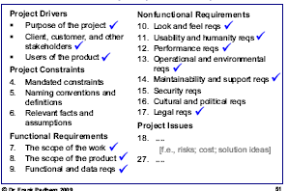
Volere »Reqs Spec Template

Slide 38
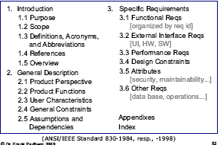
IEEE Guide to SRS

Slide 39
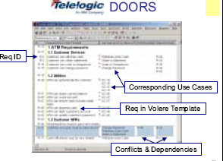

Slide 40
A word on tools
"Despite the claims of some vendors,
there is no requirements tool that can
actually interview a user or determine
what your client really needs."
(Robertson, p. 348)

Slide 41
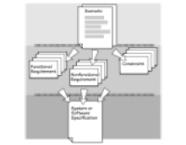
Where are we now?

Slide 42

Volere Step 4: Quality Gateway

Slide 43
Quality gateway
is the gateway into the specification
each potential req must be tested before it enters the spec
that is, we are talking about the quality of the reqs and spec itself
can be (and should be) done incrementally,
whenever the analysis of a use case is completed

Slide 44
Why test requirements?
recall that most defects originate in
requirements or design, and are
expensive to correct downstream

Slide 45
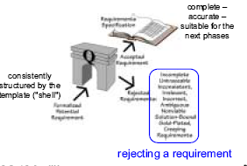
The gateway

Slide 46
Completeness and consistency
completeness and traceability of reqs to business use cases should be ensured by using the template (or reqs tool)
but better check again...
for consistency, check that terms are used consistently and match their definition given in the glossary

Slide 47
Ex: Ambiguity (1)
The product shall show the weather for a day.
a somewhat ambiguous requirement:
• its meaning depends on the context within the spec
• forecast for the next 24 hours, or until the end of this day?
• could easily be specified more precisely

Slide 48
Ex: Ambiguity (2)
The product shall communicate all roads predicted
to freeze.
another somewhat ambiguous requirement:
• its meaning depends on the context within the spec
•every road known to the product, or just the set of
roads currently examined by the user?
it helps to group reqs by product use case
but beware of "overspecifying" – this can make specs really hard to read; recall that you are just giving a description of the req

Slide 49
Ex: Relevance (1)
The product shall maintain a lookup table of the
times of sunrise and sunset throughout the year.
an irrelevant requirement:
the temperature of the road surface matters, not day or night
discard this req

Slide 50
Ex: Relevance (2)
The product shall record the durations of truck
activity.
looks irrelevant, but actually is not:
•de-icing trucks may not be scheduled for more than
20 hours out of each 24-hour period
hence, this req indirectly contributes to the project goal
this rationale should be given in the template

Slide 51
Ex: Not solutions
The product shall beep and put a flashing message
on the screen if a weather station fails to transmit
readings.
a badly shaped functional requirement:
• it contains the means of implementation
• it consignes the alert message to a screen
• there might be better solutions for the alert
(e-mail, diagnostic application, telephone)
The product shall issue an alert if a weather station
fails to transmit readings.

Slide 52
Not solutions – more examples (1)
The product shall require a password to access
account data.
a badly shaped security requirement:
again, it contains the means of implementation
it adopts the current standard solution to access control even if better solutions come up
The product shall ensure that account data can be
accessed only by authorized users.

Slide 53
Not solutions – more examples (2)
The product shall use a mouse.
a badly shaped usability requirement:
it contains the means of implementation
•changing "mouse" to "pointing device" is no better
The product shall allow the user to directly
manipulate all interface items.
express any req in its essential form, leaving the
designer free to choose the best way to implement i

Slide 54
Ex: Viability
The truck drivers shall receive weather forecasts and schedule their own de-icing.
an inviable requirement:
• truck drivers cannot predict when a road will freeze
and do not know which roads have been treated
• contradicts the constraint "targeted user group"
• discard this req
• other common reasons for inviability:
• lack of technological skills to build the req
• lack of resources to build the req
• lack of acceptance among the stakeholders

Slide 55
Other common reqs problems
gold plating: features that contribute more to the cost of a software than to its usefulness
creep: any reqs that enter the spec after it has been considered complete
leakage: unrecognized and uncontrolled creep

Slide 56
Implementing the gateway
try to keep it "lean"
often done by one analyst, supported by one tester
may involve a stakeholder
reqs are marked off when approved
formal reviews may be needed for complex, technical subject matters

Slide 57
Step 4+: Reviewing the Specification

Slide 58
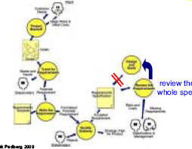
Volere RE process loop (p.322)

Slide 59
Quality of the specification
we need a quality gateway for the spec as a whole
the gateway must be in the main RE process loop – before entering design and build
the spec must be correct and complete (w/t the current release or iteration)
the spec must be suitable for its purpose (which is to serve as a basis for the design) requirements validation

Slide 60
Reviewing the spec
spans from informal reviews to full, formal software inspections
review a small pack of use cases at a time – this is an ongoing activity
check for
conflicting reqs
missing reqs
more quality reqs
inconsistent diagrams
incomplete data handling
risky and costly reqs
connects to software quality assurance,
cost estimation, and risk analysis

Slide 61
To summarize Have all Business Use cases been discovered
Strategy: for each business event, determine the work’s response (business use case) and decide how much of that response will be carried out by the product (product use case which is software)
1. Define the scope
2. Identify business events and non-events
3.Model the business use case
4.Define the business data
5.CRUD check (class,create,ref,update,delete)
6. Check for custodial processes

Slide 62
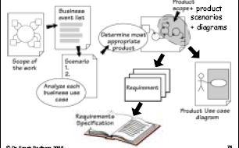
From work scope to specification

Slide 63
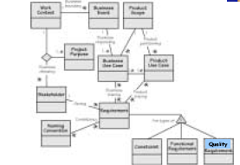
Volere knowledge model

Slide 64
Tools
mostly "low-tech paper"
scenario template
reqs shell
reqs specification template
[paper prototypes]
some software tools
diagramming tools
reqs management tools

Slide 65
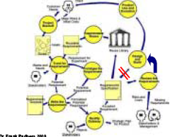
The Volere RE process

Slide 66
RE »Leftovers«
low-tech analysis prototypes
reuse of requirements
prioritizing the requirements
inspections for specifications
requirements change management
cost estimation
transition to design

Slide 67
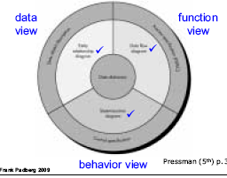
Elements of the analysis model

Slide 68
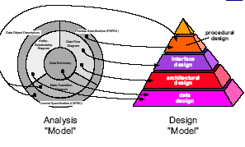
Analysis maps to design

Slide 69
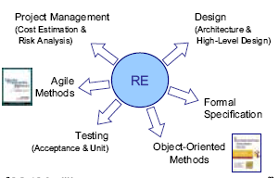
RE – reaching out...

Slide 70

THE END

